Slide 1
http://www.vidyanidhi.com/
ketkiacharya.net@gmail.com
Ketki Acharya
From: SM VITA ATC of CDAC
9769201036
ketkiacharya.net@gmail.com

Slide 2
Mongoose/ ODM
Mongoose is an Object Data Modeling (ODM) library for MongoDB and Node. js. It manages relationships between data, provides schema validation, and is used to translate between objects in code and the representation of those objects in MongoDB.
Mongoose is a JavaScript library that allows you to define schemas with strongly typed data. Once a schema is defined, Mongoose lets you create a Model based on a specific schema. A Mongoose Model is then mapped to a MongoDB Document via the Model's schema definition

Slide 3
Mongoose models provide several static helper functions for CRUD operations. Each of these functions returns a mongoose Query object.
Model.deleteMany()
Model.deleteOne()
Model.find()
Model.findById()
Model.findByIdAndDelete()
Model.findByIdAndRemove()
Model.findByIdAndUpdate()
Model.findOne()
Model.findOneAndDelete()
Model.findOneAndRemove()
Model.findOneAndReplace()
Model.findOneAndUpdate()
Model.replaceOne()
Model.updateMany()
Model.updateOne()

Slide 4
To start things off, let’s go ahead and create a fresh Node.js project with the appropriate dependencies. From the command line, execute the following:
npm init -y npm install express body-parser mongoose --save
The above commands will create a new package.json file and install Express.js, Mongoose, and a package that will allow us to pass JSON data around in our requests.
For simplicity, we’re going to keep all of our code within a single JavaScript file. Create an app.js file at the root of your project and include the following boilerplate code:
In the above code we are doing a few things.
First we are importing each of the dependencies that we had previously downloaded when creating our project.
Next we are initializing Express Framework and configuring the body-parser package so we can receive JSON data in our payloads.
The API we develop will be create, retrieve, update, and delete (CRUD) oriented hence the five endpoint functions that are prepared. We’ll be adding the MongoDB and Mongoose logic to each of these endpoint functions.
Finally, we are listening for requests to our application on port 3000.
const Express = require("express");
const Mongoose = require("mongoose");
const BodyParser = require("body-parser");
var app = Express();
app.use(BodyParser.json());
app.use(BodyParser.urlencoded({ extended: true })); app.post("/person", async (request, response) => {}); app.get("/person", async (request, response) => {}); app.get("/person/:id", async (request, response) => {}); app.put("/person/:id", async (request, response) => {}); app.delete("/person/:id", async (request, response) => {}); app.listen(3000, () => { console.log("Listening at :3000..."); });

Slide 5
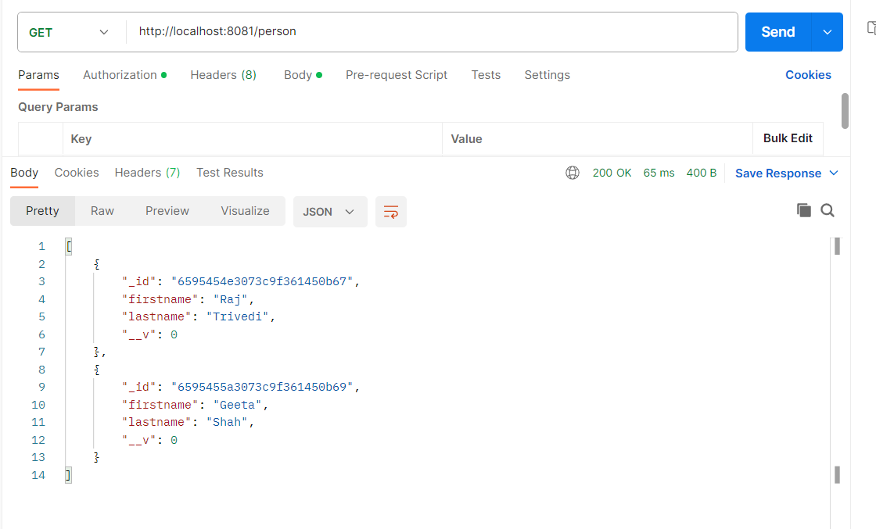

Slide 6
Interacting with MongoDB using the Mongoose ODM
With the foundation of our REST API in place, we can focus on the database logic. Within the project’s app.js file include the following near where you initialized Express Framework:
Mongoose.connect("mongodb://localhost:27017/empdb");
The above line will connect to our MongoDB instance running on localhost and it will either use or create a empdb database.
Mongoose.connect("mongodb://127.0.0.1:27017/mydb");

Slide 7
After the connection information is in place, we can define our document models. This particular example will only have a single document model that looks like the following:
const PersonModel = Mongoose.model(“person", {
firstname: String,
lastname: String
});
Our model is person which will create a people collection within our database. Each document in our collection will have the firstname and lastname properties. The model can be significantly more complex than what we have here.
So let’s take a look at each of our endpoints, starting with the creation of data:
app.post("/person", async (request, response) => {
try { var person = new PersonModel(request.body);
var result = await person.save();
response.send(result);
} catch (error) {
response.status(500).send(error);
}
});
When the client makes a POST request to our endpoint, we can use our PersonModel and the JSON payload provided to save into the database. Only the most basic of data validation is happening on our JSON payload and rather than using promises directly, we are using async and await, which in my opinion is a little cleaner. If the save is successful, we return the data back to the client facing application.
The save() function is used to save the document to the database. Using this function, new documents can be added to the database.

Slide 8
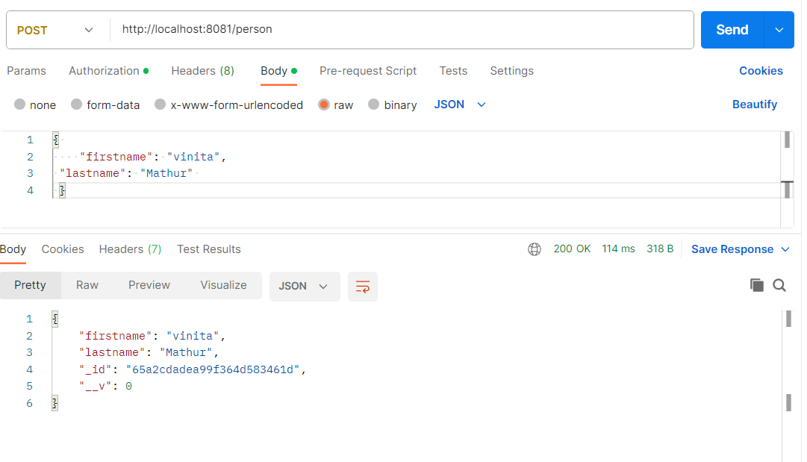

Slide 9
On the other side of things, we can try to retrieve a single document based on its stored id value:
Given an id value defined by the client facing application, we can call the findById function rather than the find function. This function will find a single document based on the associated id. When we have this data we will return it back to the user.
Basically when using mongoose, documents can be retrieved using helpers. Every model method that accepts query conditions can be executed by means of a callback or the exec method.
callback:
User.findOne({ name: 'daniel' }, function (err, user) {
//
});
exec:
User
.findOne({ name: 'daniel' })
.exec(function (err, user) {
//
});
Therefore when you don't pass a callback you can build a query and eventually execute it.
app.get("/person/:id", async (request, response) => {
try {
var person = await PersonModel.findById(request.params.id).exec();
response.send(person);
}
catch (error) {
response.status(500).send(error);
}
});

Slide 10
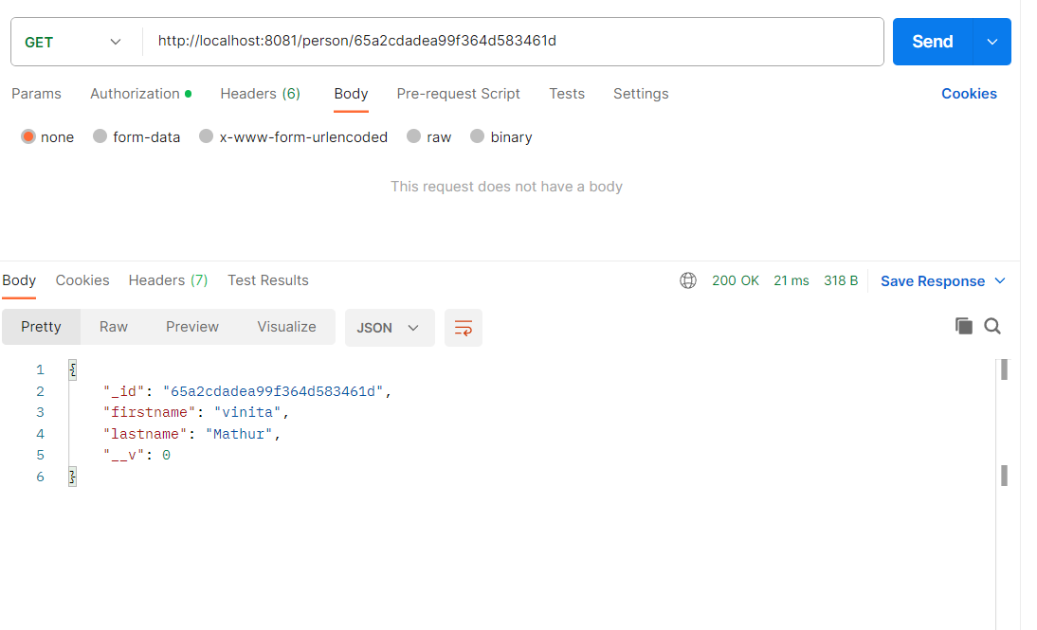

Slide 11
app.put("/person/:id", async (request, response) => {
try {
var person = await PersonModel.findById(request.params.id).exec(); person.set(request.body);
var result = await person.save();
response.send(result);
}
catch (error) {
response.status(500).send(error); }
});
When the client provides an id value, we can first find the document by the id. Once we’ve found the document, we can set the properties that were provided in the request payload. Again, basic validation is performed. For example, if a property is provided that doesn’t appear in our model, it will be stripped(removed ) out. In our model, none of the properties are required. This means whatever data appears in the payload, as long as it is valid, it will override what already exists. We can save any changes we made back to the database and return the data back to the client.

Slide 12
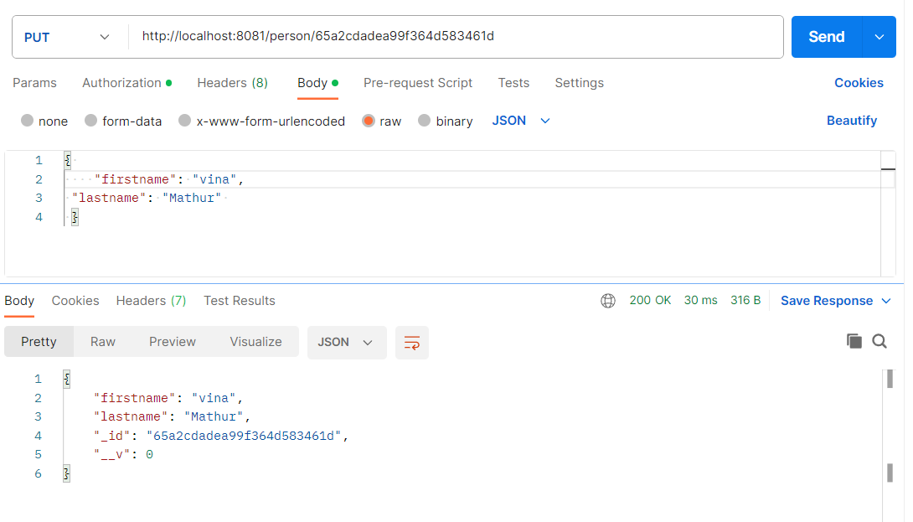

Slide 13
Again, we are expecting an id to be provided from the client facing application. When we have an id, we can use it in the deleteOne function and the document will be removed from the database.
app.delete("/person/:id", async (request, response) => {
try {
var result = await PersonModel.deleteOne({ _id: request.params.id }).exec();
response.send(result);
}
catch (error) { response.status(500).send(error); }
});

Slide 14
